Slide 1
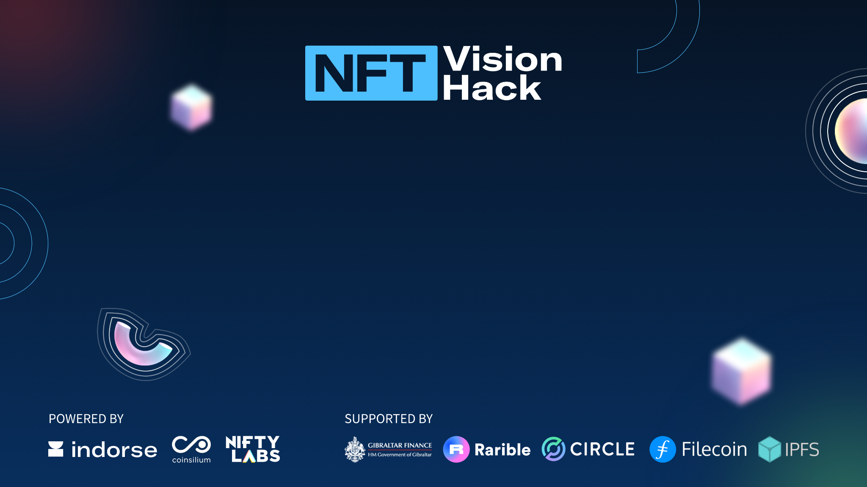
NFT Vision Hack
JUGGERNATUS

Slide 2

Introduction
Team Member - Ishan Roy (Submiting project as an individual)
• Blockchain professional with 5 years of experience working on public and private blockchain projects. Overall professional experience is 7 years
• Presently, Head, Blockchain, Tamil Nadu e-Governance Agency.
• Authored the book, Blockchain Development for Finance Projects, published by Packt Publishing.
• Member of the Expert Panel, European Union Blockchain Observatory and Forum (EUBOF)
• Areas of expertise in the field of Blockchain - E-governance, Banking and Financial Services sector.
Summary of Crypto projects I've worked on -
1. Paybito.com, decentralized cryptocurrency trading exchange
2. Designed and implemented Billbitcoins.com - Bitcoin to Fiat merchant payment gateway
3. Designed and implemented various public blockchain solutions for clients such as remittance platforms, etc

Slide 3
Track of choice
Build on Rarible Protocol
Gaming & NFTs

Slide 4
Project
My submission consisits of two components –
Myne Dapp – A DApp that allows users to NFTize their Social Media accounts. These can then be traded as tokens. This is implemented on the Rarible protocol and uses the public IPFS file system for anchoring the social media IDs to the RARI NFT token.
ERC721Nominee – Adding a ‘Nominee beneficiary’ contract to the rarible protocol. This allows users to nominate an Ethereum account to which their NFT can be transferred in case of death or incapacitation. This is implemented without modifying the existing methods of the Rarible protocol and thus can be extended to already issued RARI token NFTs. The tokens will issued will continue to be compatible with rarible , opensea and other NFT marketplaces
Please refer to the video for a DEMO

Slide 5
Technology & Tech Stack
Frontend – ReactJS – For creating the Myne Dapp UI for the user
Backend services– Node – For creating the JSON Myne wallet document which represents the ownership of the social media accounts and encrypting sensitive data
Blockchain – Ethereum (Rarible protocol) – For issuing and transfering NFTs
Distributed File Storage – IPFS – For anchoring user’s social media accounts to NFTs

Slide 6
Scalability
The technical scalability of the project is same as the existing Rarible protocol.
The adoption is expected to be high since the Metaverse (Virtual world) concept is gaining more and more traction and users are investing in digital assets. The presented solution
- Can help track ownership of and trade social media IDs as digital assets
- Provide a smart contract based framework for assigning a nominee beneficiary for digital assets (such as NFTs,social IDs, wallets, etc)

